Slide 1
PSSA Accommodations Guidelines
for
Students with IEPs and
Students with 504 Plans
January 6, 2010
Lynda Lupp, Nan Rodgers, Marlene Schechter,
Diane Simaska, Stephanie Stauffer, Mark Steciw
Edward G. Rendell,
Governor

Slide 2
Objectives
Participants will:
Examine administration procedures for the PSSA
Explore tools and strategies for choosing accommodations for students with IEPs and 504 Plans
Analyze accommodations appropriate for students with specific disabilities for the PSSA
Notes:
Here are the objectives for the presentation

Slide 3
Student Participation in Assessments
The participation of students with disabilities in assessments is assured by the following federal and state laws:
  Individuals with Disabilities Education Improvement Act of 2004 (IDEA)
  No Child Left Behind of 2001 (NCLB)
  Chapters 14 & 4 of the State Board of Education Regulations, Title 22, Education. (Pa Code 14.102 & 4.51)
Notes:
This slide is included as a reference. It identifies the legislation and regulations that govern participation of students in state wide assessment and accountability systems.

Slide 4
§ 300.160 Participation in assessments
b) Accommodation guidelines. (1) A State (or, in the case of a district-wide assessment, an LEA) must develop guidelines for the provision of appropriate accommodations. (2) The State’s (or, in the case of a district-wide assessment, the LEA’s) guidelines must—
(i) Identify only those accommodations for each assessment that do not invalidate the score; and
(ii) Instruct IEP Teams to select, for each assessment, only those accommodations that do not invalidate the score.
Notes:
This is the citation from IDEA 2004 that mandates a state to develop accommodation guidelines for students with disabilities.

Slide 5
2010 Assessment Calendar
Assessment | Dates | Grade(s)
PSSA Math, Reading, Writing, Science | April 7 – May 7 | 3 – 8, & 11
PSSA-Modified Math | April 7 - 16 | 4 – 8, & 11
PSSA-Modified Reading & Science Field Tests | May 17 - 21 | 4 – 8, & 11 (Reading) 8 & 11 (Science)
PASA Math & Reading | February 15 - March 26 | 3 – 8 & 11
PASA Science | May 3 - 28 | 4, 8, 11
ACCESS for ELLs | January 27 – March 10 | K – 12
NAEP - selected schools | January 25 - March 5 | 4, 8, 12
Notes:
This assessment calendar is posted at the PDE website. It has been included here for reference and planning purposes.

Slide 6
Participation for All
PSSA, PSSA-M
  Participate with/without accommodations
PASA
  Participate in the PASA (for students with significant cognitive disabilities).
  Adaptations for students with visual impairments, those who are deaf or hard of hearing, and/or requiring augmentative communication devices-2010 PASA Administrator’s Manual: www.pasaassessment.org
Notes:
The legislation and regulations listed in prior slides outlined the requirements for ALL students to be able to participate in statewide assessments. Pennsylvania has accommodations and guidelines for implementing those accommodations for the following assessments:
PSSA
PSSA-Modified
PASA-which has very specialized accommodations for students who have visual impairments, those who are deaf/hearing impaired, and those requiring augmentative communication devices. This training is highly specialized and occurs at a separate time from this training.

Slide 7
Accommodations vs. Modifications
Accommodations are practices that provide equitable access to test items, for example,
  More time than peers to complete tests
  Read-aloud of math and science test items
Modifications are intentional changes that might reduce performance expectations
  Requiring a student to complete fewer test items
  Giving hints or clues to make items less difficult
Notes:
An accommodation is defined as a practice to provide equitable participation.
A modification is defined as an intentional change that may reduce performance expectations.
For large scale assessment, the intent is to provide equal access to grade level content for ALL students through accommodations NOT modifications.
In the large scale testing setting, when one changes the test item by reducing the number of items to be completed, providing hints or clues, paraphrasing, defining terms, and/or explaining, that item is modified for that student. Every other student has responded to the standardized test item as it was written. By changing the standardized test item, one can no longer be sure that that the same skill is being measured. Therefore, what is measured may have been changed and thus the score would be invalid. Accommodations do NOT change what the test item is measuring.
In the classroom setting, unintended consequences of modifications may reduce the opportunity to learn critical content. Examples in the classroom include:
requiring a student to learn less materials
reducing assignments and completing only the easiest items
revising assessments to make them easier (on the test, reducing four choices to three choices)
giving hints or clues
It is recognized that some instructional modifications do occur for students with disabilities as stated above, however, it is not appropriate for these modifications to occur on the state assessment—the PSSA.
One may ask how do accommodations and modifications impact the PSSA-M. One may ask, “Isn’t the PSSA-M a modified assessment?”
The PSSA-M is designed to be an ALTERNATE assessment based on MODIFIED academic achievement standards.
The PSSA-M still measures grade level content, however, items have been modified in a standardized way for all students. As a result, the achievement expectations or performance level descriptors will be modified, thus the PSSA-M.

Slide 8
Assessment
Accommodations
It is critical to note that although some accommodations may be appropriate for instructional use, they may not be appropriate for use on a standardized assessment (i.e. the PSSA & PSSA-M tests).

Slide 9
Accommodation Categories
Presentation
Response
Setting
Timing/scheduling
Notes:
The 2010 PSSA and PSSA-M Accommodations Guidelines is organized into the accommodation categories listed above.
Presentation accommodations: allow students to access information in ways that do not require them to read standard print visually. These alternate modes of access include:
Auditory
Multi-sensory
Tactile
Visual
Response accommodations: allow students to complete assignments, tests, and activities in different ways or to solve or organize problems using assistive devices or organizers
Setting accommodations: change the location in which a test or assignment is given or the conditions of the assessment setting
Timing/scheduling accommodations: increase the allowable length of time to complete a test or assignment and may change the way that time is organized

Slide 10
Accommodations for the PSSA-M
All accommodations that are available for the general PSSA are also available for the PSSA-M.
The IEP Team should continue to consider all four accommodation categories.
Notes:
All accommodations that are available for the general PSSA are also available for the PSSA-M.

Slide 11
Accommodations for the PSSA-M
Suggestions for administration that may impact accommodations
  Setting
  Timing/scheduling
Notes:
The PSSA-M Math is different from the PSSA Math in that there are:
Fewer items per section
Fewer sections (2 versus 3)
Test booklet design (PSSA-M math is a stand alone booklet in which the answer can be recorded.)
Students may take all math sections and all reading sections rather than alternating reading, math, reading, math.
Therefore, PDE recommends a separate setting for the administration of the PSSA-M.
Note: For those students who require the same test setting as their peers, every effort should be made to provide that.

Slide 12
Documenting Accommodations in the IEP or 504 Plan
Consideration of special factors --
  Assistive technology devices and services
Supplementary aids and services --
  Aids, services, and other supports
Participation in assessments --
  How will a student participate in state and district-wide assessments
Notes:
The IEP Team will be able to determine allowable accommodations on the state assessment by examining current instructional and assessment practices and/or accommodations that are part of the IEP against the PSSA Accommodations Guidelines for Students with IEPs and Students with 504 Plans. Key sections of the IEP that will inform this process include:
Consideration of special factors
Supplementary aids and services
Present levels
Specially Designed Instruction
Section IV of the IEP, Participation in State and Local Assessments is where the accommodations that will be made available per the state assessment be documented.
504 Plan
Section 504 of the Rehabilitation Act of 1973 requires public schools to provide accommodations to students with disabilities even if they do not qualify for special education services under IDEA.
Examples of students who may receive assessment accommodations based on their 504 plans include students with:
Communicable diseases
Temporary disabilities resulting from accidents
Allergies or asthma
Drug or alcoholic addictions
Environmental illnesses
Attention difficulties

Slide 13
What Doesn’t Work?
Providing an accommodation that the student does not use on a regular basis in an assessment situation
Not getting input from the general education teachers
Including every accommodation available on the IEP form, hoping “something” will work
Notes:
We recognize that subscribing to certain accommodations practices on assessment day does not make good sense. These include:
Using an accommodation during the PSSA that the student has not used before or only in a limited way
Providing an accommodation that may be allowable in an instructional setting but NOT on a state assessment
Doing the same thing for every student in the classroom without regard to individual needs
Providing every accommodation possible
The tendency to recommend the use of a variety of accommodations, with the assumption that "the more accommodations, the better, " or "at least something will help" does not necessarily enhance a student's access to a test.
Every student with a disability does not need an accommodation, nor do all students with the same disability need the same accommodations. For example, students with low vision may simply wear glasses or contact lenses, or use a hand held magnifier, computerized magnification, several different sizes of enlarged print, Braille, or audio presentation.
A student with difficulty reading print because of a learning disability may use no accommodation, a human reader, a cassette tape or compact disc, or a screen reader. The ultimate effectiveness of the use of an accommodation depends on a student's familiarity and opportunity to practice using it.
Steps to Selecting Assessment Accommodations:
What is used by the student in that subject for classroom instruction?
What is used by the student in that subject during assessment?
Is the student familiar with the accommodation and does the student find it beneficial?
Do any other teachers of the IEP team have suggestions for accommodation use based upon classroom assignments and testing?

Slide 14
Of the Accommodations that Match the Student’s Needs, Consider …
The student’s willingness to learn to use the accommodations
Opportunities to learn how to use the accommodations in classroom settings
Conditions for use on state assessments
See Teacher Tool 1
Notes:
Of the accommodations that are determined to meet the student’s needs AND match what is allowable per the state assessment, it is important to take into consideration the points above. (list them)
If the IEP Team prefers a structured approach for determining appropriate accommodations per the four accommodation categories, the team may reference Teacher Tool 1.
Teacher Tool 1 is included in the PSSA Accommodations Guidelines for Students with IEPs and 504 Plans. It focuses on specific needs and disabilities of a student and does so in a manner that highlights needs in the four accommodations categories that may warrant accommodations. It consists of 31 Y/N/DK questions that guide the IEP Team through possible needs of the student regarding instruction and assessment.

Slide 15
Involve Students
Involve students in selecting, using, and evaluating accommodations.
The more input students have in selecting, the more likely the accommodations will be used.
Students should see accommodations as adding value to daily life — not only in school but in postsecondary, career, and the community.
See Teacher Tool 2
Notes:
Additionally, Teacher Tool 2 examines the student perspective regarding accommodations. Specifically it gets at “where” the student does well (which class) and “what” the student does well. This may lead to “why” do you do well in that class or on those activities?

Slide 16
Questions to Guide Evaluation at the School/District and Student Levels
Are students receiving accommodations as documented in the IEP and 504 plans?
What is the plan for ensuring students receive documented accommodations?
What is the student’s perception of how well the accommodation worked?
See Teacher Tool 3
Notes:
Teacher Tool 3 works to ensure that sure test administrators are not just giving all accommodations to all students because it is easier than individualizing! Teacher Tool Three helps the team insure that the accommodation information is ready to be shared for assessments and that test administrators know what accommodations to implement, who is to implement, where to implement and how to implement.
This tool will also has an evaluative/feedback component to it. At the conclusion of the assessment window, it allows a teacher, test administrator or test coordinator:
To ensure the meaningful participation in state and district-wide assessments
To reveal questionable patterns
To identify needs of team members, test administrators, or others for additional training and support
Decide whether the student should
Continue using an accommodation “as is”
Use an accommodation with changes
Discontinue accommodation use

Slide 17
Questions to Guide Evaluation at the Student Level
What is the student’s perception of how well the accommodation worked?
What seem to be effective combinations of accommodations?
What are the difficulties encountered in the use of accommodations for a student?
What are the perceptions of teachers and others?
Notes:
Just as it is important to involve the individual student prior to the assessment and gain their perspective about accommodations use, it is just as important to get their feedback following the assessment. One can collect valuable information that may benefit the student in the classroom setting as well as for future state testing.

Slide 18
Assessment
Accommodations
It is critical to note that although some accommodations may be appropriate for instructional use, they may not be appropriate for use on a standardized assessment (i.e. the PSSA & PSSA-M tests).
18
Notes:
18

Slide 19
Exceptions to Participation in PSSA
Participates in the PSSA-M for Math
  This student will participate in general Reading PSSA
Participates in PASA for Math & Reading, Science
  This student will participate in a teacher-created alternate assessment for writing
Optional participation in Reading and Writing for 1st year ELL students
Parental request for religious exclusion
Notes:
PSSA-M and PASA participation is decided by the IEP team
Must meet all four criteria for the PSSA-M:
http://www.education.state.pa.us/portal/server.pt/community/special_education/7465/assessment/607491
and all six criteria for the PASA:
http://www.education.state.pa.us/portal/server.pt/community/special_education/7465/pasa_information/619900
PSSA-M for math only in 2010
PSSA-M for reading and science in 2011
Parental request MUST be explained

Slide 20
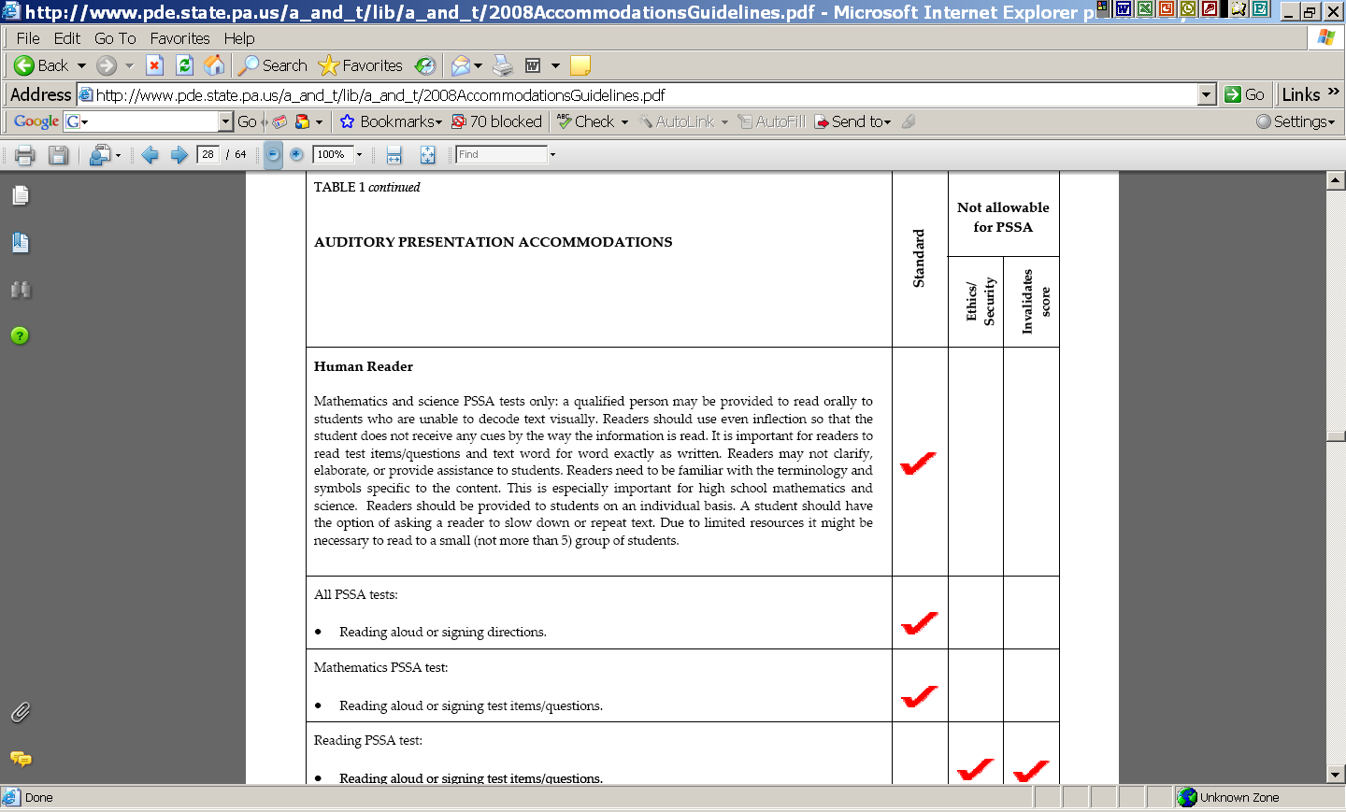
Notes:
First column is the accommodation category. A brief description of each accommodation is provided. This description may be applicable for instruction as well as assessment. Therefore, the next three columns MUST be read to determine eligibility for the PSSA and PSSA-M test(s).
Second column indicates the accommodation is a standard accommodation. A standard accommodation is allowable for the PSSA test.
Third column indicates the accommodation is a non-standard accommodation for the PSSA and PSSA-M test(s). A non-standard accommodation is NOT allowable for the PSSA and PSSA-M test(s). This column is further divided into two more columns that indicate the reason for the accommodation to be not allowable:
Ethics/Security
Invalidates score
Detailed test practices listed in the first column can be matched to either a “Standard” (allowable) accommodation or “Not Allowable” accommodation. If an accommodation is not allowable for the PSSA and PSSA-M tests, the reason is checked in either or both the “ethics” column or the “invalidates score” column.

Slide 21
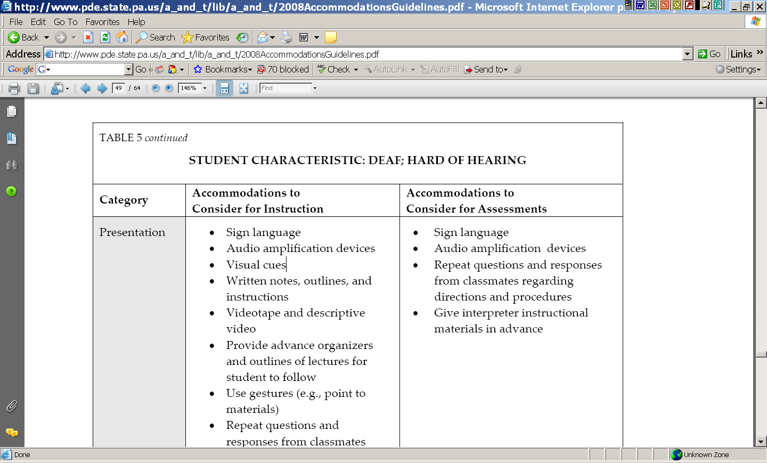
Notes:
Table 5 provides some examples of accommodations that might be considered for instruction and/or assessment for specific student characteristics. This not an exhaustive table. Educators are encouraged to consult PDE, PaTTAN, or the regional IU regarding accommodations that may not be listed.
It is important to note that not all accommodations listed in the instructional column appear in the assessment column.

Slide 22
Audio CD for Test Items
PSSA Math and Science only
Intended for limited number of students who cannot access printed version of PSSA test
Student(s) must already receive audio presentation for instruction and assessment
Request for approval from PDE must occur. Documentation MUST be submitted to PDE at time of audio test order (see Guidelines for instructions)
CDs must be ordered from and returned to DRC
Notes:
The audio CD is for a very limited number of students. Data regarding the use of this accommodation has been examined to determine the statewide use of this accommodation. Therefore, PDE does not anticipate an unusual number of requests. The audio version is intended to accommodate those students who do not access printed material for instruction and assessment.
The availability of a prerecorded audio version of the PSSA test replaces the previous audio version accommodation that required an LEA to do the recording. Individual recording of the PSSA or PSSA-M test(s) is NOT ALLOWABLE. ALL audio versions MUST be ordered through Data Recognition Corporation (DRC).
2010 orders will be placed outside of the Enrollment Verification Window. DRC will broadcast ordering instructions to the LEAs for this year. 2011 and beyond orders will be placed during the Enrollment Verification Window at the same time as other special version orders.
There will be no PSSA-M or Spanish audio version for 2010.
The following restrictions apply:
Test administrator opens the electronic audio files of the PSSA tests using school computers that do not go home with the students.
Test administrator must monitor all test sessions.
Students may use a school computer to type open ended responses.
NO printed or electronic copy/version of the electronic documents may be saved, forwarded, e-mailed, or otherwise kept or distributed by or to any person whatsoever.
All student responses must be marked by the students or transcribed by the test administrator into regular PSSA answer booklets.
All electronic and printed copies of student responses must be completely erased and/or destroyed.
At completion of test, the entire PSSA audio file must be completely removed from the computers’ hardware and/or other data storage device.
All CDs MUST be accounted for and returned to DRC with the regular test materials.
Accurate documentation of this accommodation must be kept in the students’ files.
5. A copy of the documentation indicating use of audio recording for instruction and assessment must be sent to:
Diane Simaska
Division of Assessment, 9th floor
Commonwealth of Pennsylvania
Department of Education
333 Market ST
Harrisburg, PA 17126-0333
OR
Lynda Lupp
Bureau of Special Education, 7th Floor
Commonwealth of Pennsylvania
Department of Education
333 Market ST
Harrisburg, PA 17126-0333
Documentation must include:
Cover letter and PSSA Audio Version Accommodation Request Form *
IEP information including
Cover page
Present levels OR specially designed instruction page
Section IV of State and Local Assessment
*PSSA Audio Version Accommodation Request Form can be obtained by contacting the Bureau of Assessment and Accountability or the Bureau of Special Education:
Diane A. Simaska | Basic Educational Associate II
Bureau of Assessment and Accountability
Division of Assessment
Pennsylvania Department of Education
333 Market Street | Harrisburg PA 17126-0333
Phone: 717.346.8064 | Fax: 717.783.6642
dsimaska@state.pa.us| www.education.state.pa.us
OR
Lynda A. Balmer-Lupp, M.Ed.Adm.|Special Education Adviser
Bureau of Special Education
Division of Compliance and Monitoring Central
Pennsylvania Department of Education
333 Market Street|Harrisburg PA 17126-0333
Phone: 717.783.6885|717.783.6139
lylupp@state.pa.us | www.education.state.pa.us

Slide 23
Accommodation Procedures
Document, document, document…
Provide training
Communicate and collaborate with Test Coordinator
Map out the logistics
Prepare for the implementation of accommodations prior to, during, and after the assessment
Notes:
Part IV of the IEP should be completed carefully and thoughtfully well in advance of the PSSA test window; do not make hasty decisions during PSSA-Panic time.
Distribute & explain accommodations for students in regular class for ALL assessments
Read-aloud without prompting i.e., inflection, repeated directions for a question that you know student has answered incorrectly.
Small group: not more than 5
Maintain test security
Read, read, read, DFA and HACA:
Test administrators in regular group
Test administrators in small group
Test administrators in make-up group
Readers, scribes, interpreters
Avoid instances where student(s) do not receive accommodation because test coordinator may not have been aware
Students often do not feel the importance of doing their best when there is confusion in logistics. Students must be treated respectfully in order to facilitate best performance.
Avoid confusion and controversy with test administrator by making accommodations transparent ahead of time.

Slide 24
Prior to Assessment
Know the accommodations to be provided
Know how to administer them
Know where extended-time and read-aloud will take place
Use accommodation forms/databases to monitor implementation.
Notes:
Students must be provided with appropriate accommodations- It’s the law!
Test administrators must adhere to guidelines so that student scores are valid.
Plan carefully with test coordinator. All special education students should not take the same form of test. Plan accordingly with test coordinator when planning small group read alouds. If a school has a large number of same grade level students who require read aloud, de-spiraling test forms to accommodate groups of 5 may be allowed BY THE TEST COORDINATOR ONLY.

Slide 25
During the Assessment: Ensure Standardization
Standardization: The adherence of uniform administration procedures and conditions during an assessment
Strict adherence to guidelines helps to ensure that test results reflect individual student learning
The objective of providing assessment accommodations is to make fair comparisons with other students taking the test

Slide 26
During the Assessment: Practice Ethical Testing
Unethical testing practices are inappropriate interactions between test administrators and students taking tests
  Coaching student during tests
  Editing student responses
  Giving clues in any way
  Changing the content by paraphrasing or offering additional information

Slide 27
During the Assessment: Ensure Test Security
Ensure the confidentiality of test questions and answers
Maintain test integrity and validity
This becomes an issue when accessible test formats are used or when someone other than the student is allowed to see the test
Notes:
PDE Policy – Test Security
The assessments rely on the measurement of individual achievement. Any deviation from assessment procedures is strictly prohibited and will be considered a violation of test security.
School administrators, teachers and any other education personnel who are involved in the assessment program must maintain the security of all assessment materials at all times.
Because the assessment must remain secure, teachers/Test Administrators should not have assessment materials in their possession at any time other than during the actual assessment administration.

Slide 28
After the Assessment
Complete Bubble Sheet
Permanently delete files
Return ALL material
  Student booklets
  Alternate test versions
  Original student work
  Scratch paper
Notes:
Accommodations bubbles should be completed after the assessment.
NO permanent or temporary files may remain in the computer’s memory.
All CDs, enlarged print, Braille, and regular print test materials must be returned to DRC.

Slide 29
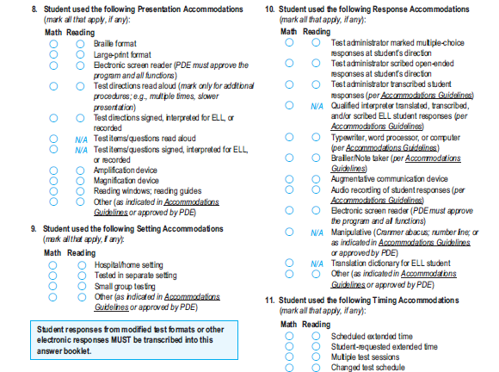
Notes:
Bubble in individual student accommodations after the test.
Each accommodation category is grouped separately.
Accommodation must be bubbled in separately for Math and for Reading.
Use of audio for presentation of PSSA Math and/or PSSA Science tests is indicated at “Test items/questions signed, interpreted for ELL, or recorded”.

Slide 30

Section Break
Questions???
Notes:
30

Slide 31
Student Characteristics
Communication
  Oral
  Sign language
Amplification
Degree/configuration of hearing loss
Impact upon education
31
Notes:
Students who are deaf or hard of hearing have unique linguistic, environmental, and cultural needs. According to the American Speech and Hearing Association, it is widely accepted that hearing is critical for the development of speech, language, communication skills, and learning.
The students who are hard of hearing have residual hearing and process information primarily auditorally and often use speech reading to understand spoken English.
Students who are deaf have little or no hearing and often process information visually; many of these students use sign language to receive and express language. Since there are varying degrees and types of hearing loss, communication methods are based on the student’s individual needs and preferences. Many students may also use a combination of communication modes, plus amplification. There may be significant language delays which may be critical in achievement.
Relatively NEW: Since July 1, 2008, a Communication Plan is required as part of a student’s IEP to ensure rich discussion regarding full access to the general education curriculum – since communication impacts daily learning.
31

Slide 32
Review of Auditory Accommodations
Student Characteristics
Auditory Accommodations
32
Notes:
32
Many students who rely on audition may use hearing aids and/or use assistive listening devices. Hearing aids amplify sounds – all sounds including, such as fans, students yelling …. Assistive listening devices use a microphone/transmitter positioned close to the speaker’s mouth to send his/her voice through the air (or by cable) to the receiver worn by the student. Assistive listening devices may provide clear sound over distances, eliminate echoes, and reduce surrounding noises so that a good listening environment may be established. So… remember whatever noises are present in the environment will be amplified for the student!
The student uses the same auditory accommodation during testing as he/she uses during instruction to ensure optimal access.
There should not be any new surprises – trying new equipment – during testing.

Slide 33
Accommodations do NOT…
Change, lower, or lessen learning, or reduce assessment expectations.
  Example: Require a student to learn less material.
  Example: Revise assignments or tests to make them easier.
Result in implications that could adversely affect a student throughout his/her educational career.
CFU: Reducing learning and lowering expectations are called ____________.
33
Notes:
33
Answer is? modifications

Slide 34

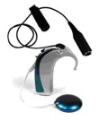
Standard Allowable Accommodations
Sign language
Assistive listening devices
Hearing aids
Extended time
34
Notes:
34
These 4 accommodations may be used separately or in combination – as documented on the student’s communication plan (IEP)

Slide 35
Sign Language
A sign language interpreter needs to translate accurately in the student’s preferred mode of communication.
If the test is not administered one-on-one, no more than 5 students may be grouped together.
  All students in the group must be given the same test form number.
35
Notes:
35
“Accurately” refers to the sign choice and concept being tested. For ex. if a science question is asking … What would produce a higher number of molecules………? The concept of higher number would be signed as an increased number, not higher as in the concept of height. An improper sign choice would greatly effect the student’s response.
Following our first VC on accommodation guidelines, we received numerous calls to verify if in fact only 5 students could be grouped together. The answer is yes – due to the large number of students with the same disability who would then receive the same form of the test. As a result, the state may not obtain the data it needs based on the same form given to a high number of students with the same disability.

Slide 36
Sign Language
An interpreter may have access to the test form 3 days prior to administration.
An interpreter may only access the test in a secure setting.
  The assessment and preparation notes may not leave the building.
An interpreter is required to sign a confidentiality agreement when viewing the test ahead of time.
36
Notes:
36
The sign language vocabulary, big ideas, and concepts that need to be signed for the math and science sections, and the writing prompts on the PSSA, require an in-depth study of the best conceptually accurate translation. This requires additional time of preparation to ensure that the students who are d-hh see the same questions as their peers. It means that there needs to be advanced planning to reserve a secure room for the interpreter to work and prep. In addition, it will mean obtaining a sub for that interpreter so he/she may adequately prep. As always, confidentiality is critical and will require an agreement to be signed.
*ADVANCED PREPARATION IS ESSENTIAL TO ENSURE THAT AN ACCURATE INTERPRETATION WILL BE CONVEYED.

Slide 37
Sign Language
The following sections of the PSSA are allowed to be signed
  Directions for all tests
  Math items/questions
  Writing prompts
  Science items/questions
37
Notes:
37
Be sure to verify which students need to have these sections presented in sign language to enable them to receive the questions using accommodations that levels the playing for them and yet does not change expectations. We want to know the student to show what he or she knows, so… if instruction, modeling, directions, test items are signed in daily instruction, the same needs to be done during assessments.

Slide 38
Sign Language
The following sections of the PSSA are NOT allowed to be signed
  Reading passages, multiple-choice questions and answer choices
  Writing multiple-choice passages, questions, and answer choices
38
Notes:
38
Emphasize the above info, as signing the reading or writing questions would invalidate the student’s test.

Slide 39
Sign Language Message Delivery
All test items must be signed as they are written, except when doing so would reveal an answer to a test question.
Interpreters may not paraphrase, clarify, elaborate, or provide assistance with the meanings of words, intents of test questions, or responses to test items.
39
Notes:
39
For ex., if a geometry question for a 3rd grader is asking to identify a triangle and the iconic sign shows a triangle – this would automatically give the answer to the student and provide an unfair advantage. Inform the participants that they will be viewing a video of a math item and a writing prompt signed in allowable and non-allowable versions. Ask how the two differ.

Slide 40
Sign Language Message Delivery
Math: Grade 5 E.2.1.2
46. Steve’s phone book listed the following area codes for his friends.
Steve’s Friends: Name and Area Code
Han 916 Rosa 831
Ji 209 Tito 916
Liang 908 Wally 831
Matt 209 Zoe 209
Paula 805
What is the mode of the area codes?
A 209 *
B 805 middle, as listed
C 831 median; listed twice
D 916 listed twice
40
Notes:
Ask why the two versions differ? Which is an accommodation and which version is a modification? 1st or 2nd?
40

Slide 41
Sign Language Message Delivery
Informational writing prompt (Grade 8)
Write an essay about an unusual food you have eaten. Explain what makes it so unusual.
41
Notes:
41
Ask how the two versions differ and how they would effect the outcome…

Slide 42
Assistive Listening Devices
Students may use amplification devices in addition to their hearing aids (the same equipment used during instruction time).
Notes:
  Provide fresh batteries when testing.
  Reduce ambient noise.
42
Notes:
42
Some types of cochlear implants have attachments (sometimes called a boot) that are used for increased sound detection.
Again, the need for planning ahead is critical!

Slide 43
Extended Time
Students who are deaf or hard of hearing may need more time than the rest of the regular education testing group (allowable accommodation).
English may be the second language for some students so they may require additional time to read and comprehend the meaning of each question.
43
Notes:
43
Emphasize second bullet…

Slide 44
Extended Time
Decisions should be made on a case-by-case basis prior to the administration of the PSSA.
  Avoid disruption
Students may move to an extended time area.
There must be sufficient time to complete a section prior to the end of the school day.
44
Notes:
44
An impt reminder… the decision for extended time needs to be considered on a case by case basis and documented on the student’s IEP prior to administration of the PSSA. Many students may need this extra time, while others may not.
Avoiding disruption is key – IF a student finishes early and fools around and disrupts others, perhaps the decision for extended time may need to be revisited.

Slide 45
Extended Time
Test sections must be administered in sequence.
Students should have extended time as long as they are working productively.
45
Notes:
45
This accommodations needs to be closely monitored.

Slide 46
Assessment
Accommodations
It is critical to note that although some accommodations may be appropriate for instructional use, they may not be appropriate for use on a standardized assessment (i.e. the PSSA & PSSA-M tests).
46
Notes:
During instruction, educational interpreters often use what are called expansions - they add information to key vocabulary to assist in understanding text. This strategy would not be allowed during test administration.
46

Slide 47
Section Break
Questions???
Notes:
47

Slide 48
Review of Accommodations for Students with Visual Impairments (VI)
Student Characteristics
Accommodations vs. Visual Modification
What’s new (new items are in red and italicized)
48
Notes:
48
These are the two areas we will be covering in this part of the presentation.

Slide 49
Assessment
Accommodations
It is critical to note that although some accommodations may be appropriate for instructional use, they may not be appropriate for use on a standardized assessment (i.e. the PSSA & PSSA-M tests).
49
Notes:
49

Slide 50
Student Characteristics
Student characteristics
  Low incidence/heterogeneous population
  Visual impairment
    Blind
    Low vision
Access to instructional materials and testing
  Visual access (print/pictures)
  Auditory access
  Tactual access (Braille/graphics)
  Combination of access and/or accommodations
50
Notes:
50
The population of students with VI can best be described as low incidence (07-08 Penn Data – 1150 – deceiving – primary disability only) and heterogeneous, ranging from totally blind to functional vision. In addition, students with VI can display very high cognitive functioning as well as those students with severe cognitive disabilities. Students with low vision can have very functional vision, requiring very few accommodations, to very limited functional vision which would require more significant accommodations.
Students with VI access their instructional materials (this is the biggest challenge) in four ways:
Visually
Auditory
Tactually
Combination – students with VI may use a variety of access modes and accommodations, depending on the materials presented and or the situation

Slide 51
Key Concepts when Considering Accommodations for Students with VI
Many students with visual impairments need accommodations to access instructional and testing materials.
Guard against over accommodating and recognizing that when changes to the content or level of expectation occur, it may become a modification rather than an accommodation.
Accommodations “level the playing field.”
51
Notes:
51
Students with VI may need accommodations in the four areas discussed earlier –
Presentation: LP/braille; AT – CCTVs and screen readers;
Response: Braille
Setting: quiet room or accessible to electricity and their AT
Timing and scheduling: extended time
In general, always guard against over-accommodating – e.g. overuse of personal aides – no planning for reducing the dependency and building self determination – independent learners.

Slide 52
Specialized Test Formats
  Braille/tactile graphics
  Enlarged print
  Must be ordered from DRC
  Order forms are included with testing materials
52
Notes:
52
Highlight that ordering Braille and enlarged print from DRC unless larger than standard is needed – you must contact PDE if this is the case.

Slide 53
Tactile and Visual Presentation Accommodations (Page 25, 26)
Braille/Enlarged Print
IEP teams need to utilize appropriate learning media assessments to determine optimal print size for sustained reading tasks
LEAs should contact PDE @1-717-787-4234 if a student requires Braille or print larger than 18 point type for a specific section of text
53
Notes:
53
Explain what a LMA is:
Conducted by a TVI and an O&M specialist
Ongoing
Emphasize “sustained reading” – not just wcpm – need information on 20-30 sustained reading.
Highlight ordering information from PDE (new) for Braille and enlarged print
Note: PSSA tests cannot be produced locally in Braille and enlarged print.

Slide 54
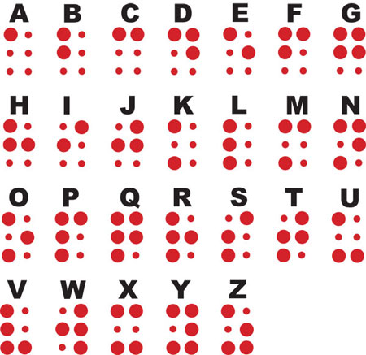
Notes:
Braille:
- Using a cell which contains six positions, a combination of raised dots corresponds to print letters. Students use the tip of their fingers to discriminate the configuration of the raised dots. Uncontracted Braille uses a one to one relationship between the Braille cell and the corresponding letter; contracted Braille uses a combination of cells to represent common words and/or prefixes and suffixes. Show what brl would look like.

Slide 55

Notes:
General rule – 2.5 pages of Braille to 1 page print.

Slide 56
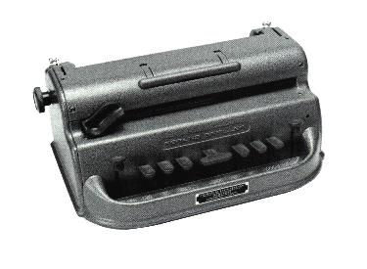
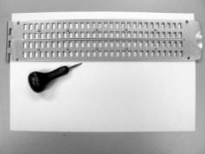
Notes:
Upper left: Perkins Brailler
Lower right: slate and stylus

Slide 57
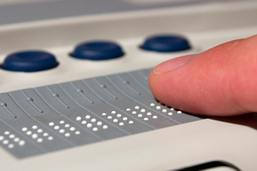
Notes:
Refreshable Braille: using a screen reader, Braille cells change their configuration by popping up and receding to represent what is displayed on the screen or in the text.

Slide 58
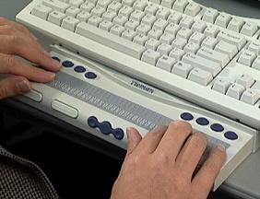
Notes:
Another example – attached to a standard keyboard.

Slide 59
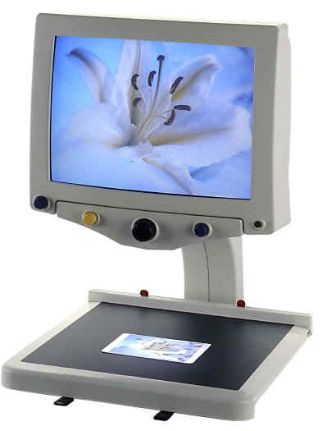
Notes:
Using electronic magnification, the student with low vision is able to place print/pictures/objects on the reading table (show) and a camera (show) takes the image and enlarges it on the screen (show). Most commonly used AT for students with low vision.

Slide 60
Visual Presentation Accommodations
Electronic magnification
Screen Magnification Software
  Some students use enlarged computer monitors and/or screen enlargement programs or computer operating system accessibility options. Must follow all guidelines for electronic readers.
60
Notes:
60
(Page 26)
Highlight use of accessibility features of the computer’s operating system.
Remember that you must follow the all guidelines for electronic readers that were discussed earlier. If disabling the spellchecker is an issue, use of the computer as an accommodation must be carefully monitored.

Slide 61
Electronic Readers (Screen Reader and/or Text Reader)
Must meet all 4 criteria:
Used routinely in this subject both before and after PSSA
Severely limited or prevented from participating without it (not simply performing below grade-level expectations)
Documented in IEP or 504
PDE has granted approval prior to test window
61
Notes:
61
- Pages 31, 32
The PSSA test is not available electronically at this time. However, if a student cannot access the assessment any other way than electronically, and exception may be granted by PDE. Exceptions may be granted on an individual basis using the following guidelines:
Intended for students with severe disabilities
Cannot access test without technology
Software program must have all functions required for test taking
Must not invalidate student responses
To submit a request for a special exception, contact PDE by calling or emailing:
Diane Simaska
717-787-4234
717-346-8064
dsimaska@state.pa.us

Slide 62

Notes:
Zoom Text is just one example of screen enlargement software that enlarges text on a computer screen. Many students will use the accessibility features built into the operating system to enlarge text and increase contrast.

Slide 63
Multi-Sensory Presentation Accommodations
Electronic readers: Intended for those students with a severe disability that precludes them from accessing the test…
  Scan and Read Programs
  Screen readers
63
Notes:
63
(Pages 31-32
The use of electronic readers was previously discussed, but we want to emphasize that it very much applies to students with VI – prime example is Kurzweil 1000 – a scan and read system. Also JAWS – see next slide.

Slide 64
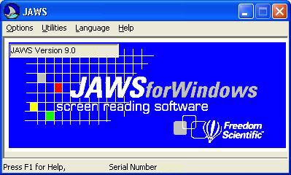
Notes:
JAWS for Windows is an example of a screen reader that enables students to hear what is presented on a computer display or other text. You also need JAWS for refreshable Braille.

Slide 65
Response Accommodations
Braille writing devices
Computers
Note-taking devices
Adapted PDAs
Enlarged print
65
Notes:
65
Many students with VI use handwriting which would not be an accommodation.
Keyboarding needed for computers.
PLEASE NOTE: These are examples of products – PDE does not endorse the use of specific equipment.
Show example on following slides.

Slide 66
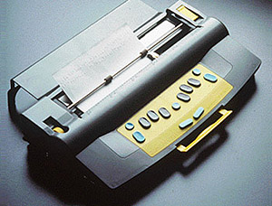
Notes:
Responses can be entered using a traditional pen and pencil, a felt tipped pen, keyboarding, a scribe, a brailler or state and stylus.
The Mountbatten is an example of an electronic brailler.

Slide 67
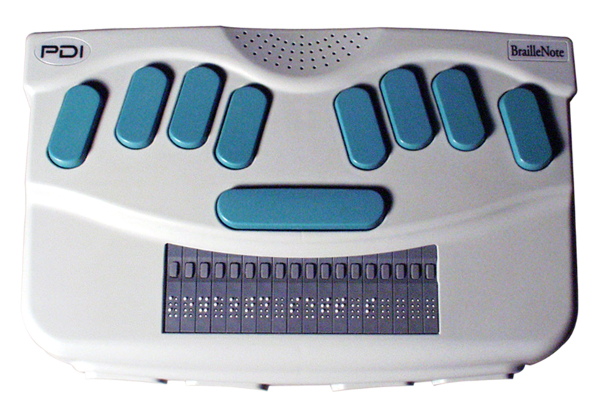
Notes:
The Braille Note is an example of a portable note taker with speech and refreshable Braille. It also has many other capabilities that allows it fall in the category of an adapted PDA.

Slide 68
Electronic Braille Writer, Note-Taking Devices, and Adapted PDAs
  Allowable for PSSA tests with following conditions:
    Braille or standard input may be printed out in text form
    Student responses must be transcribed into the regular scannable test booklet
    Not allowable: Use of spell/grammar checker, auto correct, word prediction functions, internet functions, stored files or other supports
    If the note-taking device is connected to a computer, guidelines for use of an electronic reader apply
68
Notes:
68
It is permissible for a student who is taking the PSSA writing test to enter in Braille on any of these devices – then the TVI or other designated person, can use the back translator (taking Braille input and translating it into print format). This saves a large amount of time that would be required for the TVI to transcribe the Braille. HOWEVER – a student’s responses MUST still be transcribed into the regular scannable test booklet.

Slide 69
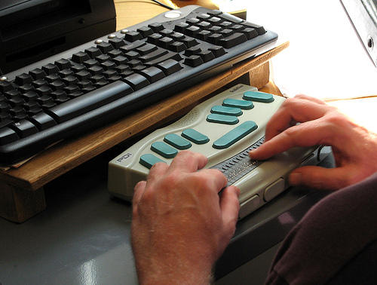
Notes:
Note taker attached to a computer

Slide 70
Materials or Devices Used to Solve or Organize Responses
A Cranmer abacus may be used when math problems are to be calculated without a calculator. The abacus functions as paper and pencil for students with visual impairment
Use of a number line (enlarged print or Braille)
Use of enlarged print and/or tactile rulers
  Tactile rulers do not measure less that 1/16”.
70
Notes:
70
(Page 40)
Only the numbers and markings on the number line/ruler are enlarged – not the device

Slide 71
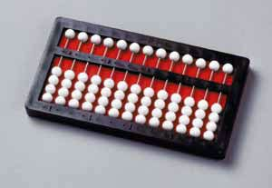
Notes:
Cranmer abacus

Slide 72
Notes:
APH number lines

Slide 73
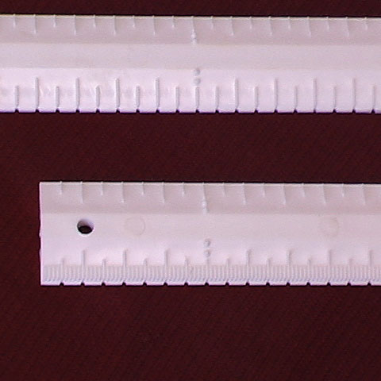
Notes:
Tactual ruler

Slide 74
Setting Accommodations
A student with low vision may bring appropriate task lighting to the test situation.
74
Notes:
74
(Page 41)
See next slide for example

Slide 75
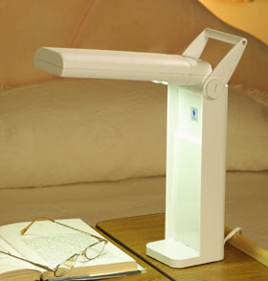
Notes:
Portable task light

Slide 76
Timing and Scheduling Accommodations
Extended Time
  Should be determined by IEP team based on learning media assessment results
  Remember to “raise the bar.”
76
Notes:
76
(Page 45)
Discuss the issue of automatically providing extra time to students with VI – it should be assessed to see if it is needed and/or beneficial. For example, if data shows that a student is reading 100 wpm, and same age peers are reading 200 wpm, your student may require extended time, but…
IEP teams should always be raising the bar by providing instruction that will enable the student to become more fluent and reduce the dependency on extended time – relate this to transition – post secondary education and employment.

Slide 77
Assessment
Accommodations
It is critical to note that although some accommodations may be appropriate for instructional use, they may not be appropriate for use on a standardized assessment (i.e. the PSSA & PSSA-M tests).
77
Notes:
77

Slide 78
Section Break
Questions???
Notes:
78

Slide 79
Review of Multi-Sensory Accommodations
Student Characteristics
Multi-Sensory Accommodations vs. Multi-Sensory Modification
79
Notes:
79
In this section we will discuss multi-sensory accommodations. We will discuss:
Student characteristics – what students would need a multi-sensory accommodation?
As was said in an earlier slide--guard against over accommodating and recognize that when changes to the content or level of expectation occur, it may go too far and become a modification rather than an accommodation and invalidate the score.

Slide 80
Student Characteristics
Students needing these accommodations may have difficulty with:
Communicating
Typing Writing
Spelling
Reading
Attention
Physical Access
80
Notes:
80
Students needing multi-sensory accommodations can be found throughout our classrooms and schools—they may be students who have difficulty speaking or making themselves understood verbally, those who have difficulty writing legibly, are not reading on grade level, can’t physically turn the pages of a book, difficulty attending to a task, etc, etc. They may not be readily apparent as you look at a group of students, but for those students with IEPs these characteristics should be apparent and noted in the IEP or 504 plan.

Slide 81
Human Reader
For students who are unable to decode text visually, the following sections of the PSSA
May be read aloud:
Directions for all PSSA tests
Math test items/questions
Writing prompts
Science test items/questions
May NOT be read aloud:
Reading passages
Reading questions & answer choices
Writing passages
Writing questions & answer choices
81
Notes:
81
This slide has a concise listing of allowable and non-allowable sections that may be read aloud for a student. See page 28 of the guidelines for details
See notes on previous slide regarding recordings. (Math and science tests may be prerecorded –building test coordinator is responsible for the security of all recordings—they must be collected and returned to the test contractor along with the test booklets.

Slide 82
Electronic Readers (Screen Reader and/or Text Reader)
Use intended for students with a severe disability, e.g.,
Limited motor ability
Significant vision disability
Inability to access text in any other way
82
Notes:
82
True or false: A text reader (scan and read) program may be used in certain instances during testing with permission, but never for reading the reading test aloud (true!)
You may have students in your classrooms who cannot physically turn the pages of the test or have a significant visual disability so that they are not able to use the hard copy of the test booklet. The text reader may be considered for these students.
Cannot be used to read the reading test—prior approval from PDE is required—see Appendix A of Guidelines (page 59) for contact information

Slide 83
Scribe
Writes what student dictates using an AAC device, pointing, sign language, or speech
May not edit or alter in any way
Must allow the student to review and edit what has been written
Records student responses directly into PSSA test booklet
83
Notes:
83
(Page 36)
True or False: A scribe may write down the student’s recorded response to the writing prompt essay
(False)
A scribe writes what student dictates using an AAC device, pointing, sign language or speech. It is difficult to be a scribe since you are not allowed to add or alter what is dictated and our natural tendency is to “fill in the gaps.” However, a scribe truly must write exactly what is dictated by the student. Scribes should prepare by knowing vocabulary and the limits to the assistance they can provide.
Students may dictate responses for the Math, Reading, and Science tests and test administrator may scribe the response(s) into the test answer booklet.
Students should review what has been written and edit it if needed, and the responses must be recorded into the PSSA test booklet.
It is not permissible to scribe student responses to the writing essay prompts. Some students may have a motor disability that impedes the use of a writing tool (such as pencil, keyboard, or other AAC device). Contact PDE regarding the participation in the writing PSSA test for these students.

Slide 84
Scribe
Multiple-choice and open-ended responses may be scribed for:
  Mathematics PSSA
  Reading PSSA
  Science PSSA
Writing PSSA test:
  Multiple-choice responses may be scribed
  Student may scribe own recorded response
  Responses to writing essay prompts may NOT be scribed
84
Notes:
84
(Page 36)
The student may scribe their own recorded response to the writing PSSA.
Another means of accommodating for responses is transcribing. Transcribing is the copying the student’s written, typed or keyed responses into the standard test booklet by the test administrator. Responses must be transcribed word for word, including all errors. Transcribing must take place in a secure environment under the direction of the assessment coordinator for the school when possible.

Slide 85
Response Accommodations
Augmentative and Alternative Communication (AAC) Device
A system designed to support or augment communication
  Symbols
  Letter Boards
  Written words
Student responses must be transcribed into regular test booklet
85
Notes:
85
(Page 37)
Another response accommodation is the use of an AAC device. The student may use the device to provide responses which are then transcribed into the regular test booklet.

Slide 86
Response Accommodations
Word processor
  Use of spell/grammar checker, word prediction, internet functions, stored files, and other supports are not allowed
Audio recorder—tape/CD/electronic recorder (with NO computer speech recognition)
  Use is not allowed on the writing PSSA
86
Notes:
86
(Page 38)
Other response accommodations include word processors and audio recorders. Responses must be transcribed into the test booklet

Slide 87
Response Accommodations:
Speech to Text
Must have prior approval from PDE!
Intended for students with severe disabilities that don’t allow them to produce written responses by other acceptable means
Student dictates text into the computer
Test administrator transcribes dictated responses into regular test booklet
87
Notes:
87
(Page 39)

Slide 88
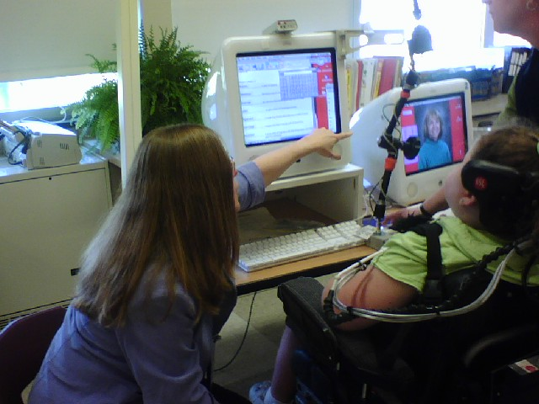
88
Notes:
88
Here is an example of a student using multi sensory accommodations to access a classroom assessment.
The student had no mobility from the neck down and was using several computer program based AT devices. The student does have normal vision and hearing.

Slide 89
Response Accommodations
It is not allowable to use:
Manipulatives other than those described in the accommodations guidelines
Calculator may not be used on non-calculator sections of the PSSA test
Preprinted graphic organizers
It is allowable to use:
Calculator or number line
Calculators with large keys or voice output
Students ARE ALLOWED to create their own graphic organizers (at the time of the test)
89
Notes:
89
(Page 40)
True or false: Students may create their own graphic organizers on scratch paper during testing
True
The manipulatives discussed as allowable on page 40 include a calculator, number line (or Cranmer abacus, as was discussed in the VI section of this presentation). Discuss allowable and non-allowable accommodations listed on this slide.

Slide 90
Setting Accommodations
Accommodations may be distracting to other students
Allow access for all students
Students using word processing software may need to be in computer labs for testing
Make sure students with mobility impairments
  Can access the test room
  Have room for wheelchairs and equipment needed for testing
90
Notes:
90
(Pages 42,43)
True or False: It is allowable for students to wear headphones (noise buffers) during testing to reduce distractions (True)
Setting accommodations alter the location in which the student participates in the assessment.
It is important to plan ahead so distractions for all may be reduced! The teacher may need to talk to the test administrator (if the teacher is not administering the test) so that arrangements can be made for a proper setting for test administration. Please have these discussions so there are no surprises on testing day.
If you are considering the following accommodations, plan for the proper setting:
The use of a reader or scribe
The need to read or think out loud
Text to speech or speech to text
If the use of a wheelchair or other mobility aids limits access to the testing environment

Slide 91
Assessment
Accommodations
It is critical to note that although some accommodations may be appropriate for instructional use, they may not be appropriate for use on a standardized assessment (i.e. the PSSA & PSSA-M tests).
91
Notes:
91

Slide 92
In Conclusion……
The goal of school is learning. Students with disabilities have the opportunity to truly show what they have learned when appropriate accommodations are paired with effective instruction and assessment.
92
Notes:
92
The goal of school is learning. Assessments are just one way—albeit a very important way—in which we find out whether students have learned or not. For many students, especially those with disabilities, being able to show what's been learned is greatly improved when teachers provide individualized instruction and appropriate accommodations in the classroom and in testing situations. The sheer variety of accommodations and assessments allows IEP teams a range of tools by which to understand and maximize student ability. Progress monitoring along the way adds an extra and powerful tool for continually checking on student growth and adjusting instruction to match student need. Carefully selecting accommodations to address student strengths, challenges, and experiences means that students with disabilities have the supports they need to access classroom instruction and then demonstrate what they've learned. Investigating and providing strategies such as accommodations that support student success can have obviously beneficial results for students—which is reason enough to provide them, plus it’s the law—but they can be beneficial for our schools as well. Schools and educational systems as a whole are accountable for the results they achieve and must demonstrate that their students are learning. Providing students with disabilities with the equipment necessary to succeed in the classroom and show their knowledge and skills in a regular assessment format means that they are truly included in the world of education.

Slide 93
Therefore……
….choose accommodations for each student thoughtfully and use them consistently while monitoring student progress to insure success for every student!
93
Notes:
93

Slide 94
Section Break
Questions???
Notes:
94

Slide 95
Accommodations for English Language Learners

Slide 96
Accommodation Categories
Presentation
Response
Setting
Timing/scheduling
and ELL-specific:
Linguistically responsive
96
Notes:
96

Slide 97
Who is an ELL?
A limited English proficient student (LEP) or English Language Learner (ELL) is one who
  was not born in the United States or whose native language is other than English and comes from an environment where a language other than English is dominant; or
  is a Native American or Alaska Native who is a native resident of the outlying areas and comes from an environment where a language other than English has had a significant impact on (the student’s) level of English language proficiency; or
  is migratory and whose native language is other than English and comes from an environment where a language other than English is dominant,
and
  has sufficient difficulty speaking, reading, writing or understanding the English language;
  and
  has difficulties that may deny (the student) the opportunity to learn successfully in classrooms where the language of instruction is English or to participate fully in our society.
97
Notes:
97

Slide 98
How are ELLs identified and placed?
The Home Language Survey, completed on enrollment, helps to identify ELLs.
Schools and districts may use other criteria as well.
Schools administer an English proficiency placement test, the W-APT, to determine the English learning needs of the student.
98
Notes:
98

Slide 99
What statewide assessments must ELLs take?
State academic achievement tests
  PSSA,
  PSSA-M, or
  PASA
State English language proficiency test
  ACCESS for ELLs
99
Notes:
99

Slide 100
1. ELLs and state academic achievement tests
PSSA or PASA Mathematics, grades 3-8 and 11; or PSSA-M mathematics, grades 4-8 and 11
PSSA or PASA Science, grades 4, 8, and 11
PSSA or PASA Reading, optional during 1st year in a U.S. school, grades 3-8 and 11
PSSA Writing, optional during 1st year in a U.S. school, grades 5, 8, and 11 (for PASA, Writing is assessed locally)
100
Notes:
100

Slide 101
PSSA and Student’s English Language Learner (ELL) status:
ELL and enrolled in a U.S. school after March 27, 2009 (previous enrollment in Puerto Rico is not considered as enrollment in U.S. schools). – PSSA Reading and Writing are optional.
ELL and enrolled in a U.S. school on or before March 27, 2009. – Must take all PSSA or PSSA-M subjects.
Exited an ESL/bilingual program and in the first year of monitoring. – These are former ELLs. Must take all PSSA or PSSA-M subjects.
Exited an ESL/bilingual program and in the second year of monitoring. – These are former ELLs. Must take all PSSA or PSSA-M subjects.
101
Notes:
When do the scores for ELL students count toward AYP?
PDE: Here is the language from the Pennsylvania Consolidated State Application Accountability Workbook, revised July 23, 2009, PP. 38-39:
“Limited English proficient (LEP/ELL) students are included in the overall accountability system as follows. An option exists for LEP/ELL students in their first year of enrollment in U.S. schools. LEP/ELL students in their first year of enrollment in U.S. schools are not required to participate in the Pennsylvania System of School Assessment (PSSA) Reading Assessment; however, if they do participate, their performance level results will not be included in the AYP calculations for the school/district, but will be included in AYP participation rate calculations for reading. LEP/ELL students in their first year of enrollment in U.S. schools must participate in the PSSA Mathematics assessment but will not have their scores and corresponding performance level used to determine AYP status. Their participation is counted in calculating the participation rate for the mathematics assessment.
“Thus, performance levels of every LEP/ELL student enrolled in the school for the full academic year, except those in their first year of enrollment in a U.S. school, are included in the school’s count. The results of LEP/ELL students enrolled in different schools within the district during the academic year are counted in the LEA’s results, and the results of LEP/ELL students enrolled in more than one district in Pennsylvania are counted in the State’s results.”
Here is the short answer: ELLs in their first year of enrollment count towards participation in AYP for Math (and for Reading, if they choose to take the test). Performance scores are not counted for ELLs in their first year of enrollment for either subject. Scores for ELLs in their second and subsequent year of enrollment do count for AYP performance; the participation of these ELLs is also counted for AYP.

Slide 102
2. ELLs and the state English language proficiency test
The ACCESS for ELLs (the English Language Proficiency assessment (Title III), is mandatory for all ELLs. It is administered annually for all ELLs, grades K-12.
The WIDA consortium develops and maintains the test. PA is a member of the consortium.
WIDA information can be found at http://www.wida.us/ . PA-specific information is available at http://www.wida.us/states/Pennsylvania.aspx .

Slide 103
ACCESS for ELLs and Student’s English Language Learner (ELL) status:
ELL and enrolled in a U.S. school after March 27, 2009 (previous enrollment in Puerto Rico is not considered as enrollment in U.S. schools). – Take ACCESS.
ELL and enrolled in a U.S. school on or before March 27, 2009. – Take ACCESS.
Exited an ESL/bilingual program and in the first year of monitoring. – These are former ELLs. Do not take ACCESS.
Exited an ESL/bilingual program and in the second year of monitoring. – These are former ELLs. Do not take ACCESS.
103

Slide 104
Who determines which testing accommodations to use?
For dually-identified students (IEP and ELL), the IEP team should be aware of ELL-specific needs and should cooperate in identifying ELL-specific accommodations.
Each school must involve the appropriate school personnel in the determination of appropriate accommodations for ELLs. The ESL/bilingual teacher, the ESL/bilingual education coordinator, other classroom teachers, the test administrator or coordinator, a parent, the principal or counselor and the student (when appropriate) may be involved in this determination. Identifying the appropriate accommodations should be a collaborative process and should include content area teachers consulting with ESL/bilingual teachers.
This determination must be done at least annually on an individual basis and must not be done for groups of ELLs.
104
Notes:
104

Slide 105
Are all accommodations applicable?
School personnel should consider the following in determining the appropriate accommodations:
  • The student’s familiarity with the accommodations to be used. Current accommodations used in day-to-day instruction and assessment are appropriate. New accommodations unfamiliar to students should not be introduced to students for the first time when they are taking the PSSA.
  • An annual review of the student’s progress in English language proficiency and academic achievement. Knowing this information will help teachers, supervisors, parents, and administrators determine which accommodations are still appropriate given the student’s current knowledge.
105
Notes:
105

Slide 106
What accommodations are available for ELLs?
Three separate accommodations are allowed specifically for ELLs in their first three years in ESL services:
  1. Word-to word translation dictionaries, without definitions and without pictures (for Mathematics PSSA, PSSA-M, and Science PSSA only; not for any part of the Reading PSSA test or on any part of the Writing PSSA)
  2. Qualified interpreters/sight translators (for Mathematics PSSA, PSSA-M, and Science PSSA only; not for any part of the Reading PSSA test or on any part of the Writing PSSA except the Writing essay prompts)
  3. Spanish/English PSSA Mathematics, PSSA-M Mathematics, and PSSA Science tests
All of these accommodations are voluntary and not mandatory.
106
Notes:
106

Slide 107
1. Word-to word (and word-phrase and phrase-phrase) translation dictionaries
Word-to-word translation dictionaries, without definitions and without pictures, are permitted for the Mathematics PSSA, Mathematics PSSA-M, and Science PSSA only; not for any part of the Reading PSSA test nor for any part of the Writing PSSA
107
Notes:
107

Slide 108
2. Qualified interpreters/sight translators
Qualified interpreters/sight translators for the content of the Mathematics PSSA, Mathematics PSSA-M, and Science PSSA only;
Not for any part of the content of the Reading PSSA test or on any part of the Writing PSSA except for translation of the writing essay prompts.
108
Notes:
108

Slide 109
2. Qualified interpreters/sight translators, cont’d
An interpreter may be used to present the instructions to an ELL in any language other than English for each PSSA and PSSA-M assessment (Writing, Mathematics, Reading, and Science) during the first three years that a student is categorized as an ELL.
For the same group of ELLs, an interpreter may be used to present the content of the test (test questions, answer choices, labels, descriptions of scenarios, and other test material) for the Mathematics PSSA, Mathematics PSSA-M and Science PSSA only (and the writing essay prompts).
109
Notes:
109

Slide 110
Translations/interpretations
Translations should be as accurate as possible. They should be literal where appropriate. Where a literal translation might create confusion (for example, if the English version contains an idiom), the meaning should be rendered faithfully but no elaboration or explanation should be provided.
110
Notes:
110

Slide 111
Further information for sight translators
Further information on procedures for PSSA and PSSA-M sight translations is available at the PDE website, in the PSSA and PSSA-M Accommodations Guidelines for English Language Learners.
111
Notes:
111

Slide 112
3. Spanish-English side-by-side versions
PSSA | Mathematics | Available
PSSA-M | Mathematics | Available
PSSA | Science | Available
PSSA | Reading | n/a
PSSA | Writing | n/a
112
Notes:
112

Slide 113
Spanish-English side-by-side versions
  PSSA Mathematics, PSSA-M Mathematics, and PSSA Science tests
For students who require translation into Spanish, it is recommended that the printed Spanish-English version of the assessment be ordered (instead of using an interpreter). This standardizes the administration.
Note also that the Spanish language version may be read aloud to the student by the test administrator, if the student’s level of literacy requires this.
113
Notes:
113

Slide 114
ELLs with IEPs and other accommodations
  Other accommodations that are specified in an ELL’s IEP continue to be allowable (given the guidance in this presentation and in the Accommodations Guidelines for Students with IEPs and 504 Plans).
114
Notes:
114
114

Slide 115
If a student has already exited an ESL Program, are ELL-specific accommodations still available?
Once a student has exited an ESL or bilingual program, the student is no longer classified as an English Language Learner and ELL-specific accommodations are no longer available.
115
Notes:
115

Slide 116
ELL-specific accommodations for PASA
The Test Administrator Guide for the 2009 PASA includes an Appendix D that mentions the use of ASL and foreign language interpreters. Please contact the PASA project for more information on foreign language interpretation for PASA.
116
Notes:
116

Slide 117
ELL-specific accommodations for ACCESS for ELLs
The ACCESS for ELLs is an English language proficiency test for ELLs. There are four component tests: Listening, Speaking, Reading, and Writing.
There are no ELL-specific accommodations for the ACCESS test.
117
Notes:
117

Slide 118
Accommodations on the ACCESS for ELLs with IEPs
The ACCESS for ELLs permits a range of accommodations for ELL students who have IEPs.
It is important not to offer an accommodation that would invalidate the skill being tested by one of the component tests – Listening, Speaking, Reading, and Writing.
The ACCESS for ELLs Test Administrator Manual provides information on available accommodations. Please consult with PDE on any accommodations for which you might have questions.
118
Notes:
118

Slide 119
Alternate ACCESS for ELLs
An Alternate ACCESS for ELLs, intended for students who are in the population served by the PASA, is in development by the WIDA consortium. At present, all ELLs must be tested using the ACCESS for ELLS.
119
Notes:
119

Slide 120
Questions on ELL accommodations?
Contact Stephanie Stauffer, Division of Assessment, Bureau of Assessment and Accountability, PDE, sstauffer@state.pa.us
References: Accommodations Guidelines for English Language Learners, PDE website; Test Administrator Manual, ACCESS for ELLs, WIDA website.
120
Notes:
120

Slide 121
Assessment
Accommodations
It is critical to note that although some accommodations may be appropriate for instructional use, they may not be appropriate for use on a standardized assessment (i.e. the PSSA & PSSA-M tests).
121
Notes:
121

Slide 122
Accommodations for English Language Learners

Slide 123
Accommodation Categories
Presentation
Response
Setting
Timing/scheduling
and ELL-specific:
Linguistically responsive
123
Notes:
123

Slide 124
Who is an ELL?
A limited English proficient student (LEP) or English Language Learner (ELL) is one who
  was not born in the United States or whose native language is other than English and comes from an environment where a language other than English is dominant; or
  is a Native American or Alaska Native who is a native resident of the outlying areas and comes from an environment where a language other than English has had a significant impact on (the student’s) level of English language proficiency; or
  is migratory and whose native language is other than English and comes from an environment where a language other than English is dominant,
and
  has sufficient difficulty speaking, reading, writing or understanding the English language;
  and
  has difficulties that may deny (the student) the opportunity to learn successfully in classrooms where the language of instruction is English or to participate fully in our society.
124
Notes:
124

Slide 125
How are ELLs identified and placed?
The Home Language Survey, completed on enrollment, helps to identify ELLs.
Schools and districts may use other criteria as well.
Schools administer an English proficiency placement test, the W-APT, to determine the English learning needs of the student.
125
Notes:
125

Slide 126
What statewide assessments must ELLs take?
State academic achievement tests
  PSSA,
  PSSA-M, or
  PASA
State English language proficiency test
  ACCESS for ELLs
126
Notes:
126

Slide 127
1. ELLs and state academic achievement tests
PSSA or PASA Mathematics, grades 3-8 and 11; or PSSA-M mathematics, grades 4-8 and 11
PSSA or PASA Science, grades 4, 8, and 11
PSSA or PASA Reading, after 1st year in a U.S. school, grades 3-8 and 11
PSSA Writing, after 1st year in a U.S. school, grades 5, 8, and 11 (for PASA, Writing is assessed locally)
127
Notes:
127

Slide 128
2. ELLs and the state English language proficiency test
The ACCESS for ELLs (the English Language Proficiency assessment (Title III), is mandatory for all ELLs. It is administered annually for all ELLs, grades K-12.
The WIDA consortium develops and maintains the test. PA is a member of the consortium.
WIDA information can be found at http://www.wida.us/ . PA-specific information is available at http://www.wida.us/states/Pennsylvania.aspx .

Slide 129
Who determines which testing accommodations to use?
For dually-identified students (IEP and ELL), the IEP team should be aware of ELL-specific needs and should cooperate in identifying ELL-specific accommodations.
Each school must involve the appropriate school personnel in the determination of appropriate accommodations for ELLs. The ESL/bilingual teacher, the ESL/bilingual education coordinator, other classroom teachers, the test administrator or coordinator, a parent, the principal or counselor and the student (when appropriate) may be involved in this determination. Identifying the appropriate accommodations should be a collaborative process and should include content area teachers consulting with ESL/bilingual teachers.
This determination must be done at least annually on an individual basis and must not be done for groups of ELLs.
129
Notes:
129

Slide 130
Are all accommodations applicable?
School personnel should consider the following in determining the appropriate accommodations:
  • The student’s familiarity with the accommodations to be used. Current accommodations used in day-to-day instruction and assessment are appropriate. New accommodations unfamiliar to students should not be introduced to students for the first time when they are taking the PSSA.
  • An annual review of the student’s progress in English language proficiency and academic achievement. Knowing this information will help teachers, supervisors, parents, and administrators determine which accommodations are still appropriate given the student’s current knowledge.
130
Notes:
130

Slide 131
What accommodations are available for ELLs?
Three separate accommodations are allowed specifically for ELLs:
  1. Word-to word translation dictionaries, without definitions and without pictures (for Mathematics PSSA, PSSA-M, and Science PSSA only; not for any part of the Reading PSSA test or on any part of the Writing PSSA)
  2. Qualified interpreters/sight translators (for Mathematics PSSA, PSSA-M, and Science PSSA only; not for any part of the Reading PSSA test or on any part of the Writing PSSA)
  3. Spanish/English PSSA Mathematics, PSSA-M Mathematics, and PSSA Science tests
All of these accommodations are voluntary and not mandatory.
131
Notes:
131

Slide 132
1. Word-to word (and word-phrase and phrase-phrase) translation dictionaries
Word-to-word translation dictionaries, without definitions and without pictures, are permitted for the Mathematics PSSA, Mathematics PSSA-M, and Science PSSA only; not for any part of the Reading PSSA test nor for any part of the Writing PSSA
132
Notes:
132

Slide 133
2. Qualified interpreters/sight translators
Qualified interpreters/sight translators for the content of the Mathematics PSSA, Mathematics PSSA-M, and Science PSSA only;
Not for any part of the content of the Reading PSSA test or on any part of the Writing PSSA except for translation of the writing essay prompts.
133
Notes:
133

Slide 134
2. Qualified interpreters/sight translators, cont’d
An interpreter may be used to present the instructions to an ELL in any language other than English for each PSSA and PSSA-M assessment (Writing, Mathematics, Reading, and Science) during the first three years that a student is categorized as an ELL.
For the same group of ELLs, an interpreter may be used to present the content of the test (test questions, answer choices, labels, descriptions of scenarios, and other test material) for the Mathematics PSSA, Mathematics PSSA-M and Science PSSA only (and the writing essay prompts).
134
Notes:
134

Slide 135
Translations/interpretations
Translations should be as accurate as possible. They should be literal where appropriate. Where a literal translation might create confusion (for example, if the English version contains an idiom), the meaning should be rendered faithfully but no elaboration or explanation should be provided.
135
Notes:
135

Slide 136
Further information for sight translators
Further information on procedures for PSSA and PSSA-M sight translations is available at the PDE website, in the PSSA and PSSA-M Accommodations Guidelines for English Language Learners.
136
Notes:
136

Slide 137
Spanish-English side-by-side versions
PSSA | Mathematics | Available
PSSA-M | Mathematics | Available
PSSA | Science | Available
PSSA | Reading | n/a
PSSA | Writing | n/a
137
Notes:
137

Slide 138
Spanish-English side-by-side versions
  PSSA Mathematics, PSSA-M Mathematics, and PSSA Science tests
For students who require translation into Spanish, it is recommended that the printed Spanish-English version of the assessment be ordered (instead of using an interpreter). This standardizes the administration.
Note also that the Spanish language version may be read aloud to the student by the test administrator, if the student’s level of literacy requires this.
138
Notes:
138

Slide 139
If a student has already exited an ESL Program, are ELL-specific accommodations still available?
Once a student has exited an ESL or bilingual program, ELL-specific accommodations are no longer available.
139
Notes:
139

Slide 140
ELL-specific accommodations for PASA
140
Notes:
140

Slide 141
ELL-specific accommodations for ACCESS for ELLs
The ACCESS for ELLs is an English language proficiency test for ELLs. There are four component tests: Listening, Speaking, Reading, and Writing.
There are no ELL-specific accommodations for the ACCESS test.
141
Notes:
141

Slide 142
Accommodations on the ACCESS for ELLs with IEPs
The ACCESS for ELLs permits a range of accommodations for ELL students who have IEPs.
It is important not to offer an accommodation that would invalidate the skill being tested by one of the component tests – Listening, Speaking, Reading, and Writing.
The ACCESS for ELLs Test Administrator Manual provides information on available accommodations. Please consult with PDE on any accommodations for which you might have questions.
142
Notes:
142

Slide 143
Alternate ACCESS for ELLs
An Alternate ACCESS for ELLs, intended for students who are in the population served by the PASA, is in development by the WIDA consortium. At present, all ELLs must be tested using the ACCESS for ELLS.
143
Notes:
143

Slide 144
Assessment
Accommodations
It is critical to note that although some accommodations may be appropriate for instructional use, they may not be appropriate for use on a standardized assessment (i.e. the PSSA & PSSA-M tests).
144
Notes:
144

Slide 145
References
www.ccsso.org/content/pdfs/AccommodationsManual.pdf
http://www.portal.state.pa.us/portal/server.pt/community/testing_accommodations___security/7448
http://www.pasaassessment.org/AdminSecure.jsp
Notes:
http://www.pde.state.pa.us/a_and_t/lib/a_and_t/2008AccommodationsGuidelines.pdf

Slide 146
References
The Online Accommodations Bibliography at the National Center on Educational Outcomes (NCEO) is a source of information on the range of possible accommodations as well as the effects of various testing accommodations for students with disabilities:
http://cehd.umn.edu/nceo/AccomStudies.htm
Parent guide and information on Alternate Assessments:
http://www.ed.gov/parents/needs/speced/learning/index.html

Slide 147
CONTACT INFORMATION
Pennsylvania Department of Education
Bureau of Assessment and Accountability 717-705-2343
Bureau of Special Education 717-783-2311
Lynda Lupp, PDE: lylupp@state.pa.us
Diane Simaska, PDE: dsimaska@state.pa.us
Stephanie Stauffer, PDE: sstauffer@state.pa.us
Data Recognition Corporation
PA Customer Service 1-800-451-7849
147

Slide 148

Office of Elementary/Secondary Education
Diane Castelbuono, Deputy Secretary
Bureau of Assessment & Accountability John Weiss, Director
Division of Assessment Ray Young, Division Chief
Bureau of Special Education, John Tommasini, Director
Central Division of Compliance Monitoring & Planning Richard Moss, Division Chief

Slide 149
The mission of the Pennsylvania Department of Education is to lead and serve the educational community, to enable each individual to grow into an inspired, productive, fulfilled lifelong learner.
149
Notes:
149

